Slide 1

RESUME BUILDER WEB APP
SUBMITTED BY
AKASAPU AKHIL(24P35A0501)
CHIKOTI SATISH(24P35A0509) DUVVADA LAKSHMI PRASAD(24P35A0515)
BENDALAMPOTTI SIVANI(23P31A04D9) NETHALA VINAY(24A95A0513)

Slide 2
INTRODUCTION
The Resume Builder Web App is designed to simplify resume creation.
It uses AWS cloud services for seamless, scalable deployment.

Slide 3
PROBLEM STATEMENT
Many users, especially students and freshers, struggle to create well-formatted resumes.
Traditional resume-making tools are either too complex or lack flexibility.
There’s a need for a scalable, user-friendly tool accessible from any device.

Slide 4
SOLUTION OVERVIEW
We developed a serverless web application with the following capabilities:
User registration and authentication.
resume form input with real-time validation.
This app allows users to input data, generate a resume using serverless AWS Lambda, and access it securely via CloudFront.

Slide 5
AWS SERVICES USED
Amazon S3: Storage for resume templates and PDFs.
AWS Lambda: Serverless backend for form handling
API Gateway: Connects frontend with Lambda functions securely.
Amazon Cognito: Manager user authentication and sessions.
CloudFront: Distributes content globally.

Slide 6
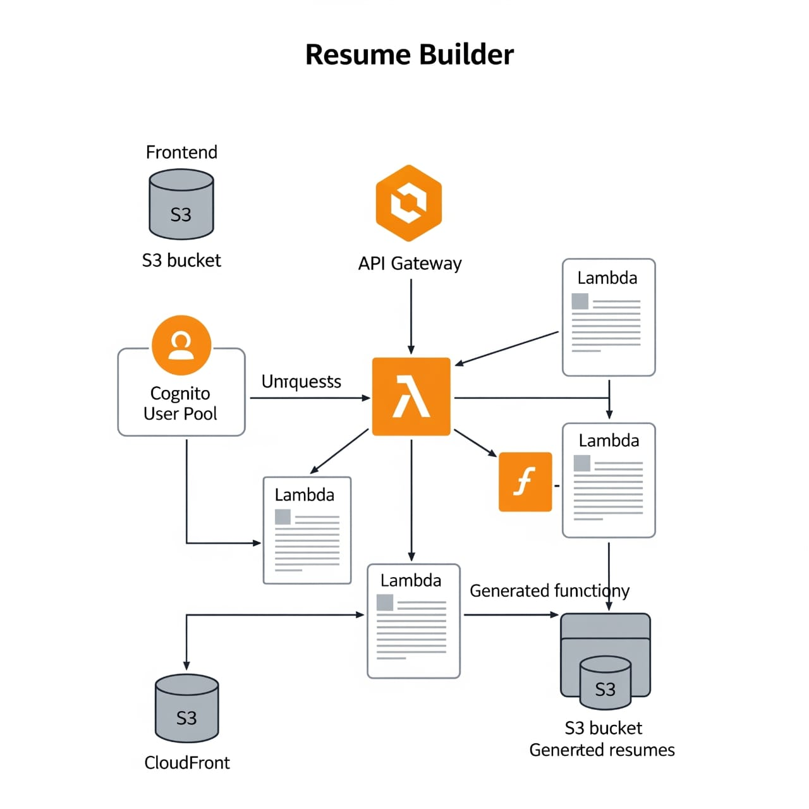

Slide 7
SYSTEM ARCHITECTURE
The architecture follows a clean, serverless model:
Frontend(HTML/CSS/JS or React) →API Gateway →AWS Lambda.
Lambda interacts with S3 for file operations and CloudFront distributes content globally.
Cognito manages user authentication and authorization.

Slide 8
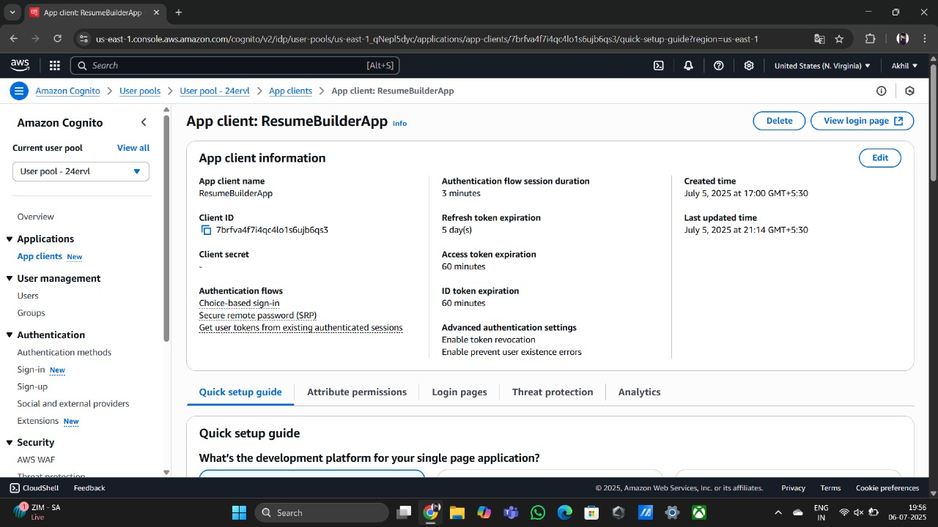
AMAZON COGNITO
Features:
Secure signup, login, logout functionality.
Integrates seamlessly with Lambda and API Gateway.
Benefits:
Scalable and secure.
No server needed for authentication.

Slide 9
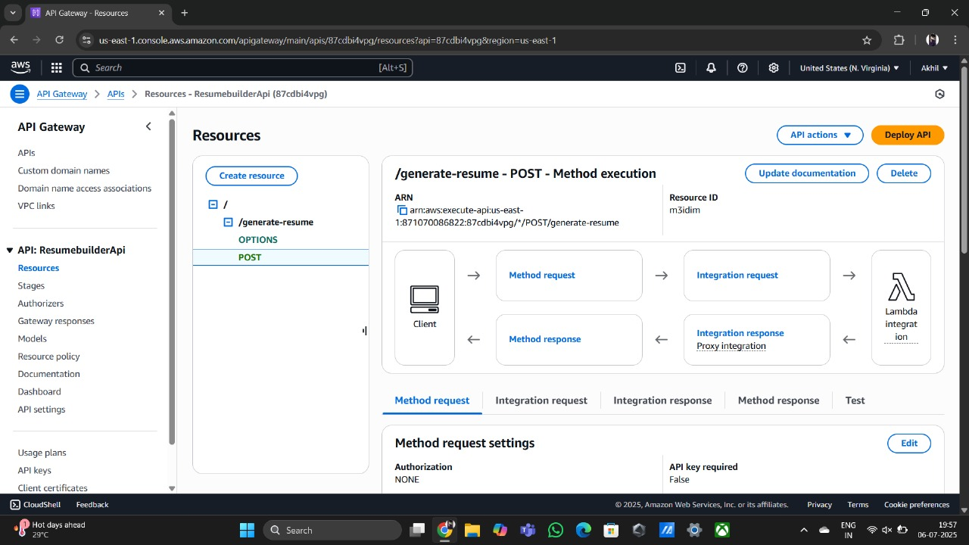
AMAZON API GATEWAY
Functions:
Acts as an interface between the frontend and lambda.
Supports HTTP methods (GET, POST).
Secures endpoints with Cognito auth tokens.
Advantages:
Centralized API management.

Slide 10
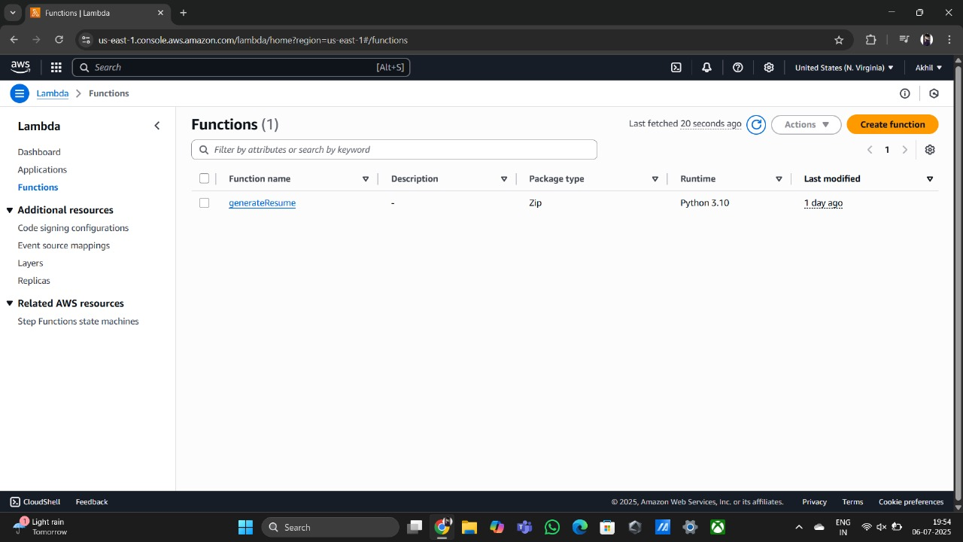
AMAZON LAMBDA
Core serverless compute platform for our backend logic:
Process input data from frontend.
Generates resume content and PDF files.
Advantages:
No server management.
pay-per-use model.

Slide 11
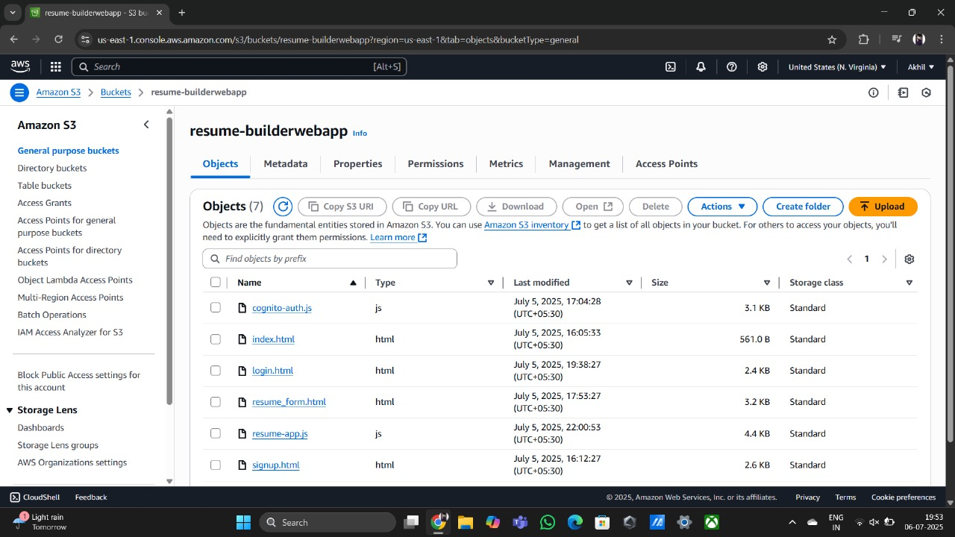
AMAZON S3
Cloud storage for static files and output documents:
Hosts resume templates.
Stores user-generated resume PDFs.
Public/Private access control with IAM.
Benefits:
Secure, scalable storage.
Easy integration with Lambda.

Slide 12
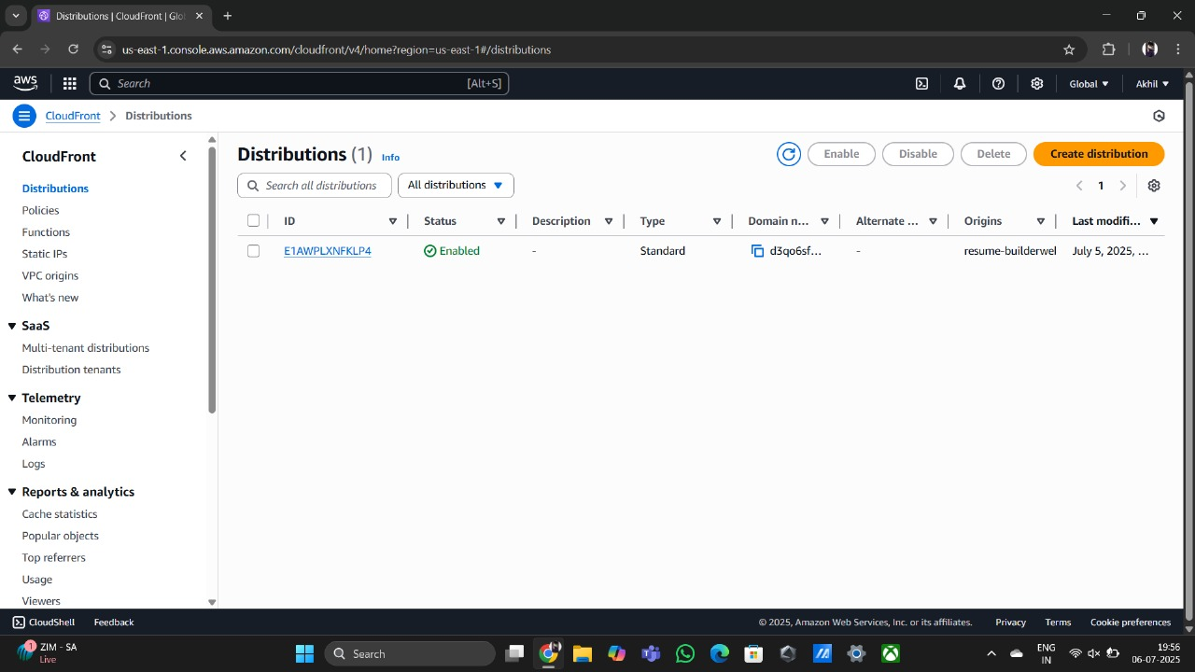
AWS CLOUDFRONT
Content delivery network (CDN).
Caches frontend assets globally.
Enhances speed, performance, and availability.

Slide 13
KEY FEATURES
Responsive Web UI (Mobile/Desktop).
Real-time Resume Preview.
Downloadable output.
Global delivery via CloudFront.
Serverless, scalable architecture.

Slide 14
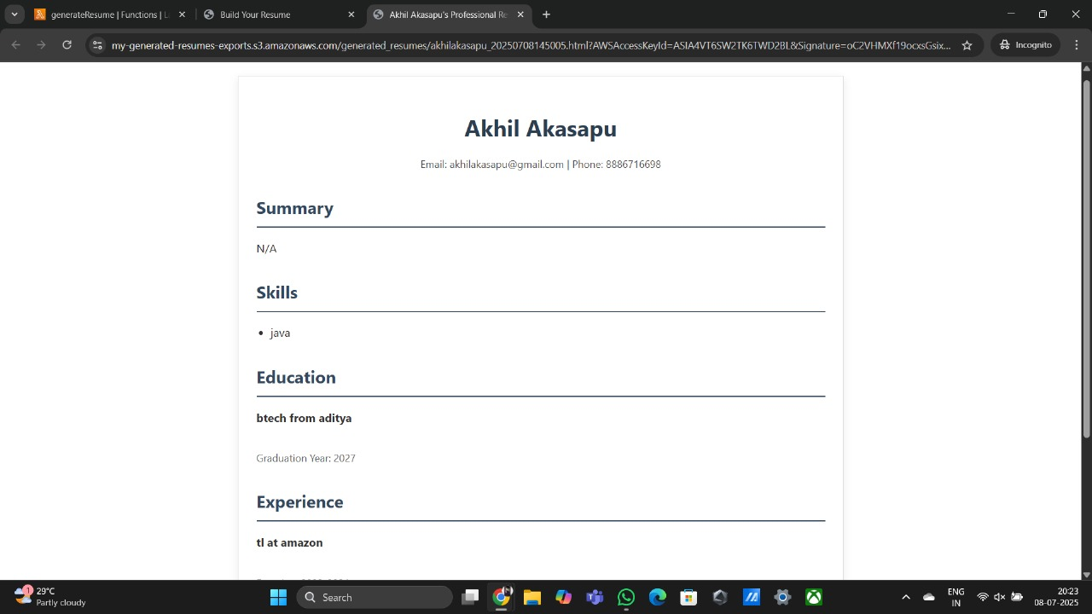
FINAL OUTPUT

Slide 15
CONCLUSION
The Resume Builder Web App demonstrates how powerful and cost-efficient a serverless AWS architecture can be.
With minimal infrastructure management, we built a robust solution ready for real-world use.
Future Scope:
Add more customizable templates.
AI integration for resume suggestions.

Slide 16
THANK YOU

